Slide 1
Module 3 Relational Data Model and CREATE TABLE Statement
Lesson 5: Assignment 1 Notes
Notes:
Welcome to Lesson 5 of Module 3 on the relational data model and the CREATE TABLE statement
Careful study of the relational data model
This lesson covers details about assignment 1.
Opening question: What university’s athletic department is the assignment database loosely derived?
Relational databases are the dominant commercial standard
- Simplicity and familiarity with table manipulation
- Strong mathematical framework
- Lots of research and development
Goals of Lesson 5
Install and use Oracle or MySQL
Write CREATE TABLE statements with correct syntax, appropriate data types, and named constraints
Execute SQL INSERT statements to populate tables

Slide 2
Lesson Objectives
Understand assignment 1 requirements
Study documentation about the assignment database (Intercollegiate Athletic Database)
Notes:
Documentation
Work flow diagram
Relational database diagram
Sample rows in the background document: not missing values in some columns

Slide 3
Intercollegiate Athletic Work Flow
Notes:
Customer initiates event request for facility usage
Event plans created for approved event requests
Assigned to an employee to manage
Collection of event plans for setup, operation, and cleanup
Details specified for allocation of resources to locations in event plan lines for each event plan

Slide 4
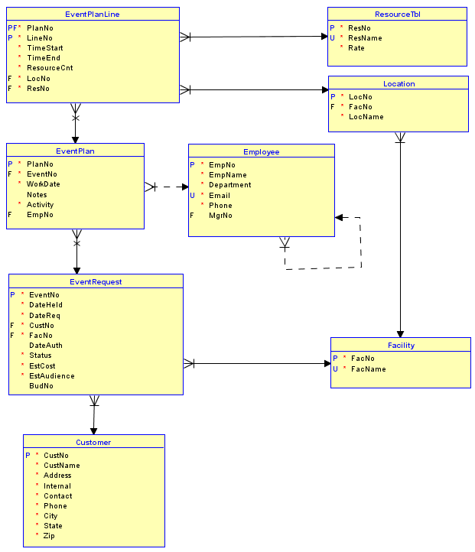
Intercollegiate Athletic Database Diagram
Notes:
Oracle relational database diagram
Based on a student project in the 1990s
Student was an employee of the UW athletic department.
Support requests and planning of events at university athletic facilities.
Moderately complex database: 8 tables, 8 relationships
Cycle in relationships: two paths between EventPlanLine and Customer
Combined PK (EventPlanLine)
Used in assignments 1 to 3
Note changes in design for Oracle
No BOOLEAN data type: use CHAR(1) for Customer.Internal with single character (Y or N) stored
Table (ResourceTbl) and column (NumberFld) changes due to reserved words in Oracle SQL
Data changes in EventPlanLine.TimeStart and EventPlanLine.TimeEnd: store date and time (DATE data type)

Slide 5
Assignment 1 Requirements
Use Oracle Cloud or PostgreSQL
Write CREATE TABLE statements
Correct syntax
Appropriate data types
Named constraints
Write directly without using visual interface
Execute SQL INSERT statements to populate tables
Notes:
Write statements without using administrator interface
Poorly written statements
Must be confident to read and write statements because CREATE TABLE statement is still widely used and relatively portable

Slide 6
Constraint Requirements
PK
FK
NOT NULL
CHECK
Names for at least PK and FK constraints
Notes:
See assignment details
Combined PK for EventPlanLine table
Must be external
Combination of PlanNo, LineNo
Most columns have NOT NULL constraints
Can be inline
Exceptions: EventPlan.EmpNo, EventRequest.DateAuth, EventRequest.BudNo, EventPlan.Notes

Slide 7
Summary
Practical skills with creating tables
Importance of CREATE TABLE statement
Importance of practice to develop knowledge and skills
Familiarity with ICA DB for assignment 1
Notes:
Assignment 1 is very practical.
CREATE TABLE statement is portable and still widely used.
Must practice to develop concepts and skills. Reading lecture notes is not sufficient.
ICA DB will be used for query formulation in assignment 2. Learning tables and relationships is important for query formulation performance.

